Slide 1
Analysis of Results from
Voluntary Assessment for
Autism Spectrum Disorder
Data source: University of California Irvine
Machine Learning Repository

Slide 2
Dataset Description
Results were based on the responses to 10 questions. Datasets were divided into three age groups, with different questions given to each age group. Data analysed in this project contains the results of the assessment for children (ages 4-11), adolescents (ages 12-16), and adults (18+).

Slide 3
Research Questions
1) Are there any gender-specific signs to look for when considering an autism diagnosis? For each of the 10 questions, are the responses significantly different by gender when compared to the diagnosis result?
2) Are there any variables that seem to be indicators of an autism diagnosis, all other factors being equal?

Slide 4
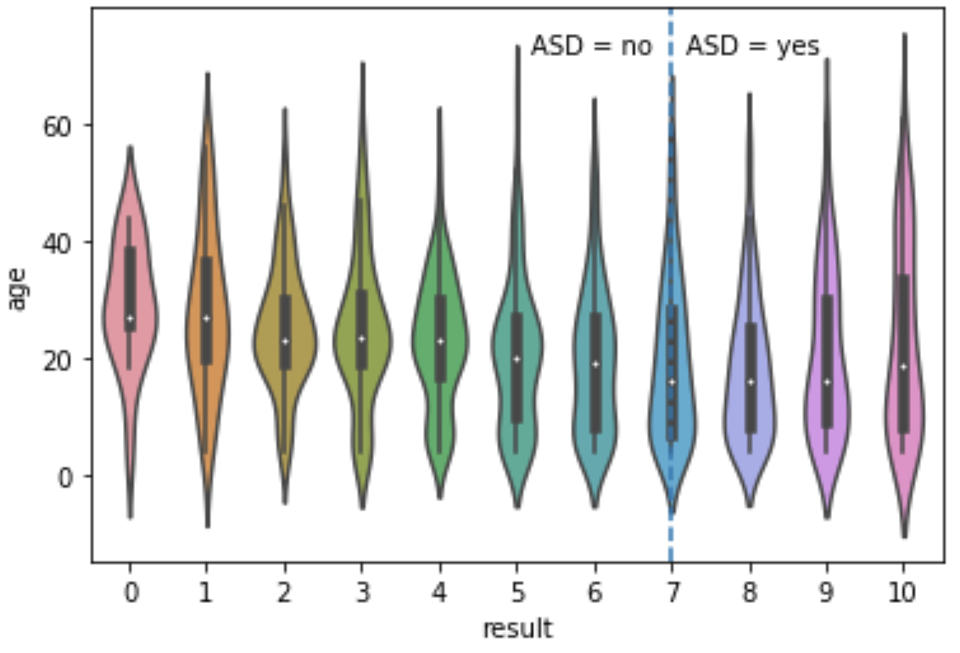
Average assessment results appear to vary significantly with age (Fig. 1), so data was broken up into age categories (4-11 years, 12-16 years, and 18+ years).
Violin plot of assessment result by age

Slide 5
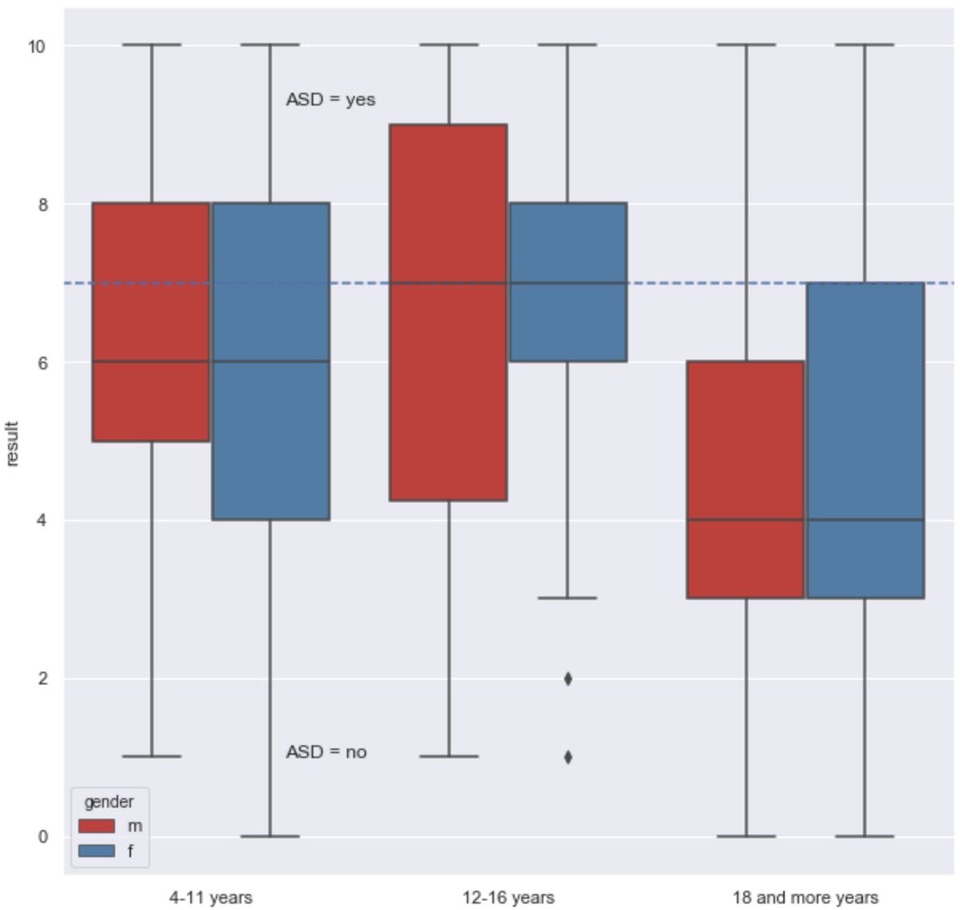
Assessment result per gender by age group
The mean result did not vary by gender across any of the age categories, but it was significantly higher for adults vs youths.

Slide 6
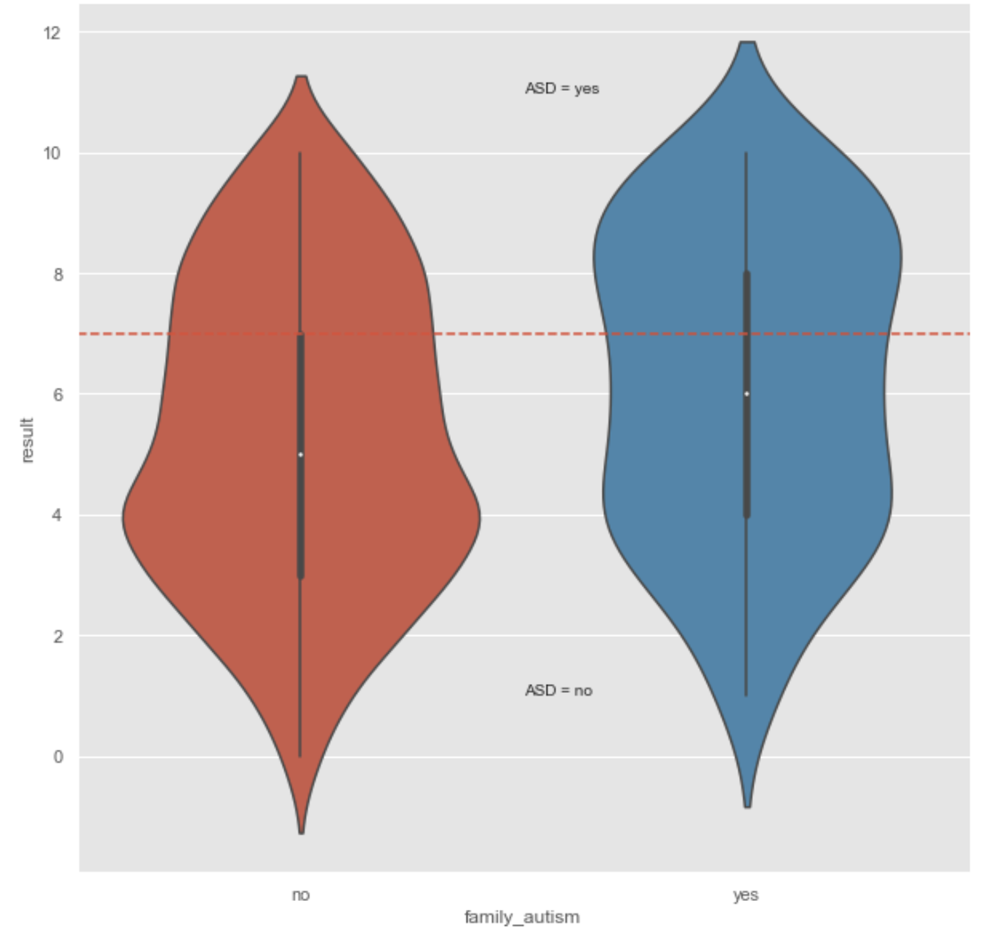
Assessment result by history of family autism
A statistical difference in assessment results was found between people with a prior family history of autism (significantly higher: p<.001) in the family and those without

Slide 7
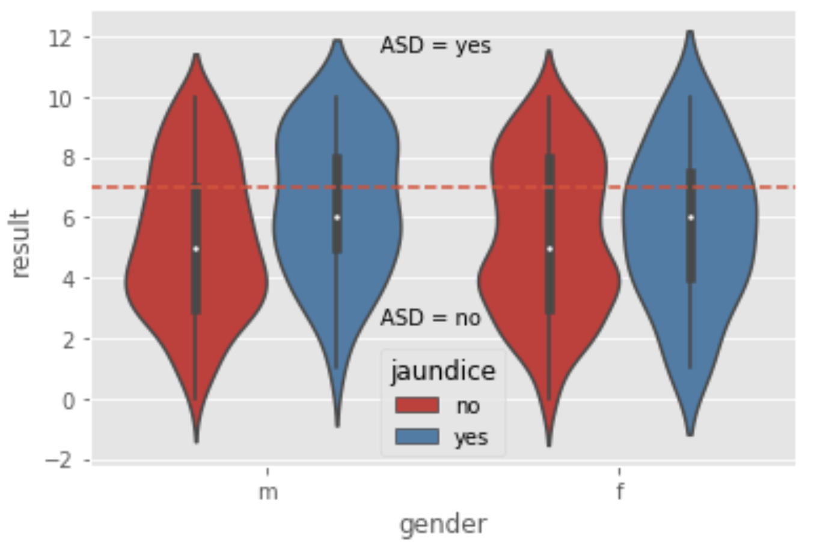
Result per gender by known jaundice at birth
There was also a significantly higher result in males known to be born with jaundice, while there was no difference for females.

Slide 8
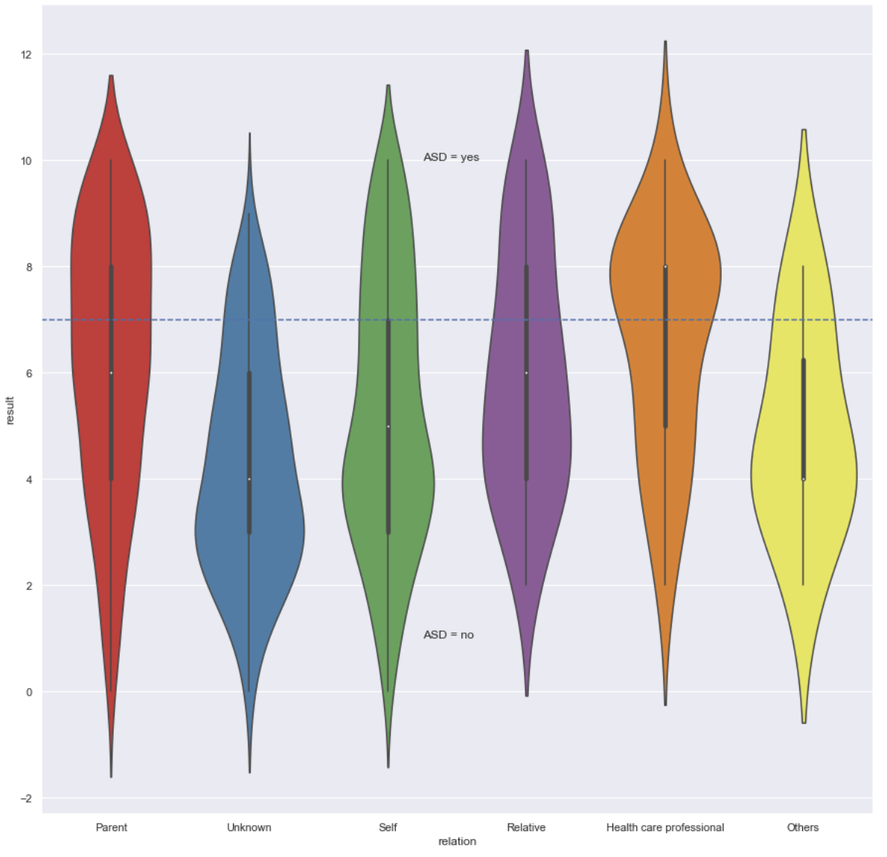
Assessment result by relation to assessee
A positive significant difference was found between results of parents and those who self-assessed

Slide 9
Assessment result per gender by age group
The mean result did not vary by gender across any of the age categories, but it was significantly higher for adults vs youths.

